Slide 1
Virtualization, Cloud, and AWS
Atul Kahate

Slide 2
Virtualization

Slide 3
Virtualization
Technology that allows a single physical computer system to run multiple virtual versions of hardware resources (such as operating systems, servers, storage, or networks) using software
Instead of using one physical machine for one task, virtualization allows many virtual machines (VMs) to run on a single physical machine
Special software called a hypervisor manages the virtual machines and allocates hardware resources
  Examples: VmWare, VirtualBox, Hyper-V, KVM
Advantages
  Better hardware utilization
  Cost reduction
  Isolation between systems
  Easy testing and deployment
  Foundation of cloud computing

Slide 4
Virtualization Types
Type of Virtualization | Description
Server Virtualization | Server resources are virtualized to create multiple Virtual Machines (VMs) on a single physical server. Each VM runs its own operating system and applications independently.
Desktop Virtualization | Allows multiple virtual desktops to run on a single physical machine. This enables centralized management, security, and remote access to desktops.
Network Virtualization | Network components such as switches, routers, and firewalls are virtualized to create a software-defined virtual network infrastructure.
Storage Virtualization | Combines and abstracts physical storage devices and presents them as a single virtual storage pool for easier management.
Application Virtualization | Individual applications are virtualized so they run in isolated environments, preventing conflicts with other applications on the system.

Slide 5
Virtualization Example
Step | What Happens
1. VirtualBox starts the VM | VirtualBox creates a virtual computer for Ubuntu by assigning virtual CPU, RAM, disk, network card, and display, using your Windows machine’s real hardware.
2. Ubuntu boots inside the VM | Ubuntu thinks it is running on a real machine, but it is actually running on virtual hardware provided by VirtualBox.
3. You open Terminal | The Terminal is just a program inside Ubuntu that lets you type shell commands.
4. You type ls | The shell in Ubuntu reads the command and asks the Ubuntu operating system to execute the ls program.
5. Ubuntu loads ls | Ubuntu finds the ls executable from its file system, loads it into the VM’s memory, and gives it CPU time.
6. Virtual CPU uses real CPU | The VM’s virtual CPU is mapped by VirtualBox to your Windows machine’s real CPU, so the instruction actually runs on the physical processor.
7. If files must be read | When ls checks the current directory, Ubuntu sends disk-read requests to its virtual disk. VirtualBox translates these requests to reads from the VM file on the Windows host.
8. Output is produced | The ls command generates the list of filenames, and Ubuntu sends that output to the Terminal window inside the VM.
9. Screen is shown on Windows | VirtualBox takes the VM’s display output and shows it in a window on your Windows desktop.

Slide 6
Virtualization Types
Feature | Type 1 Hypervisor | Type 2 Hypervisor
Location | Runs directly on the physical hardware, also called native/bare-metal virtualization | Runs on top of an existing operating system, also called para virtualization
Architecture | Hardware → Hypervisor → Virtual Machines | Hardware → Host OS → Hypervisor → Virtual Machines
Performance | Higher performance since it interacts directly with hardware | Lower performance due to extra OS layer
Typical Use | Used in data centers and enterprise servers | Used for personal use, testing, and development
Resource Control | Hypervisor directly manages CPU, memory, and storage | Host operating system manages hardware resources first
Security | Generally more secure and stable | Slightly less secure due to host OS dependency
Examples | VMware ESXi, Microsoft Hyper-V, KVM | Oracle VirtualBox, VMware Workstation, Parallels

Slide 7
Cloud

Slide 8
Cloud Computing
On-demand delivery of computing services—including servers, storage, databases, networking, and software over the Internet
Important characteristics
  On-Demand Self Service: Provision resources automatically without having to call a human being, when we need them
  Broad Network Access: Standard Internet connection is sufficient
  Resource Pooling: Provider’s resources are shared among many customers (multi-tenancy), but our data is private and isolated
  Rapid Elasticity: We can scale up or down almost instantly, based on demand/requirements
Computing becomes a “utility” like electricity

Slide 9
Why Cloud?
Before cloud
  Under-utilization: Need to build for the worst-case scenario
  Risk of under-provisioning: Sudden spikes
  High CapEx
After cloud
  Elasticity
  Economies of scale
  Focus on core business
Feature | On-Premises (In-prim) | Cloud Computing
Costs | High Upfront (CapEx) | Pay-per-use (OpEx)
Scalability | Manual & Slow (Weeks/Months) | Automatic & Instant (Minutes)
Maintenance | You manage power, cooling, hardware | The Cloud Provider handles it
Peak Loads | Pay for peak all the time | Scale up for peaks, scale down for lows

Slide 10
Cloud Service Models
Feature | IaaS (Infrastructure) | PaaS (Platform) | SaaS (Software)
Full Form | Infrastructure as a Service | Platform as a Service | Software as a Service
Analogy | Buying Ingredients: You cook the meal and set the table | Pizza Delivery: They cook it; you provide the table and drinks | Dining Out: You just sit down and eat
What YOU Manage | Applications, Data, Runtime, Middleware, OS | Applications and Data | Nothing (You just use it)
What PROVIDER Manages | Virtualization, Servers, Storage, Networking | Everything in IaaS + OS, Middleware, Runtime | The entire stack (Hardware + Software)
Best For | Maximum control & flexibility (Admins/Architects) | Developers focused on coding (Devs) | End-users wanting a quick solution
Examples | AWS EC2, Azure VMs, Google Compute Engine | Heroku, AWS Elastic Beanstalk, Google App Engine | Gmail, Salesforce, Slack, Netflix, Dropbox

Slide 11
AWS

Slide 12
AWS Infrastructure
Component | Purpose | Analogy
Region | Geographic selection & Compliance | State/Country/Continent
Availability Zone | Disaster Recovery & Fault Tolerance | City
Edge Location | Low latency & Speed | The Local Convenience Store
Region
  A physical location in the world where AWS clusters data centers
  2026: 39 Regions globally (e.g., us-east-1 in Virginia, ap-south-1 in Mumbai)
  Each Region is completely independent and isolated to ensure data sovereignty and stability
Availability Zone (AZ)
  One or more discrete data centers with redundant power, networking, and connectivity within a Region
  2026: 123 AZs
  Every Region has a minimum of 3 AZs - By spreading our app across multiple AZs, if one data center fails, our app stays online
Point of Presence (PoP)
  Smaller sites located in major cities to deliver content faster to end-users
  2026: 750+
  Used by Amazon CloudFront (CDN) to cache videos/images closer to the user to reduce "lag”

Slide 13
How a Website Uses AWS Services
Component | Simple Role | What it Does (in one line)
Traditional Setup | Single point risk | If data center fails → website goes down
Application Load Balancer (ALB) | Traffic Cop | Sends users only to healthy servers (skips failed AZs)
Auto Scaling Group (ASG) | Safety Net | Replaces failed servers automatically to maintain capacity
Multi-AZ Database (RDS) | Backup System | Keeps standby DB in another AZ and auto-switches on failure
Internet Gateway (IGW) | Doorway | Connects your VPC to the internet

Slide 14
Elastic Compute Cloud (EC2)
Flagship service: One of the most popular and foundational AWS service
Service model: Infrastructure as a Service (IaaS)
Key point: Provides resizable computing capacity in the cloud, eliminating the need to invest in physical hardware upfront
Why EC2?
  Elasticity: Scale from 1 server to 1,000 in minutes
  Flexibility: Choose OS (Linux, Windows, macOS) and hardware profile (Compute, Memory, or GPU optimized)
  Cost Efficiency: Pay-as-you-go - Turn it off when we are not using it to stop the bill

Slide 15
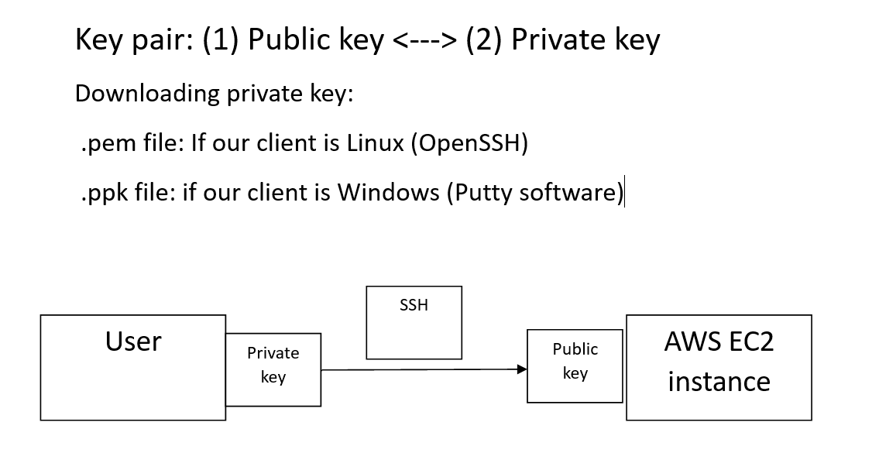
Key Pair

Slide 16
Script for Ubuntu EC2 Instance (https://github.com/newdelthis/demo)
#!/bin/bash
# Update package list
sudo apt update -y
# Install ssh server on ubuntu
sudo apt install openssh-server
sudo systemctl start ssh -y
sudo systemctl enable --now ssh
sudo ufw allow ssh
# Install Apache
sudo apt install -y apache2
# Start Apache service
sudo systemctl start apache2
# Enable Apache to start on boot
sudo systemctl enable apache2
# Open firewall
ufw allow 'Apache'
ufw enable
# Create index.html
echo "<h1>Hello World from C-DAC, Pune</h1>" > /var/www/html/index.html

Slide 17
Past Lab Exam Question
Create an EC2 instance with public IP and install Apache webserver with custom Apache page " PRN -<PRN>"
Create a snapshot (AMI) from a above running instance.
Launch a new EC2 from that AMI in a different availability zone and access the web page from the browser.

Slide 18
Create a new EC2 instance as before
Open its public IP in the browser and verify you can see Apache page
Actions → Image and templates → Create image
  Image name: PRN-AMI
  Image description: Apache webserver with custom PRN page
  Create Image
EC2 -> AMIs
  Wait till the AMI status changes to Available
Launch a new instance using this AMI
  Select the above AMI
  Click Launch instance from this AMI
  All options as before, but in subnet, select a subnet from a different availability zone
Now two EC2 instances should be running in two Azs
Try accessing their public IPs

Slide 19
Cleanup
Stop both instances
AWS -> AMI, Select our AMI and Deregister
EC2 -> Snapshots, Find snapshot for the above AMI if present and delete
EC2 -> Volumes, Filter on Owned by me -> Select all -> Detach -> Delete

Slide 20
S3
Durability Level | Probability of Data Loss
99.9% (3 nines) | 1 in 1,000
99.999% (5 nines) | 1 in 100,000
99.999999999% (11 nines) | 1 in 100 billion
S3: Simple Storage Service
Object-based storage: Stores data as objects in buckets
Scalable, Durable (11 9’s*), Secure
Access via SDKs, APIs, CLI, or Console
Common use: Static website hosting, ML datasets, backups
* If we store 10 million objects in S3 for 10 years, we can expect to lose no more than 0.001 objects over that entire period
  S3 automatically stores multiple copies of each object across multiple devices and facilities in an AWS Region
  This ensures protection against disk failure, server failure, or even facility failure
Bucket
├── Folder (logical)
│ ├── file1.jpg
│ ├── file2.pdf

Slide 21
Static Website in S3
Step | Action | Details
1 | Create S3 bucket | Create a new bucket with a unique name
1 | Configure access | Uncheck "Block all public access" (required for public website)
1 | Confirm warning | Acknowledge the warning and click Create bucket
2 | Upload files | Open the bucket and upload two files: index.html and error.html
2 | Source files | Files available at: https://github.com/newdelthis/demo

Slide 22
Static Website in S3
Step | Action | Details
3 | Select bucket | Go to the created S3 bucket
3 | Set bucket policy | Navigate to Permissions → Bucket Policy
3 | Add policy | Copy-paste from: https://github.com/newdelthis/demo/blob/main/bucket_policy.json
3 | Modify policy | Change the bucket name in the policy to your bucket name
3 | Save policy | Click Save changes
4 | Enable hosting | Go to Properties tab → Static website hosting
4 | Configure hosting | Click Edit → Enable
4 | Set documents | Enter: Index document: index.html Error document: error.html
4 | Save settings | Click Save changes
5 | Get URL | Go to Properties → Static website hosting
5 | Copy endpoint | Copy the Website endpoint URL (e.g., http://my-static-website-bucket.s3-website-us-east-1.amazonaws.com)
5 | Test website | Open the URL in a browser — your site should be live

Slide 23
Cleanup
Empty the S3 bucket
Delete the S3 bucket

Slide 24



AWS Lambda
A function that waits in the background
Becomes active and executes briefly when a particular event occurs
Runs for 15 minutes at the most, in one call
Also called callback function
I want to make a claim on my policy number 12345
Lambda Function
Handles policy claim requests
Policy Holder

Slide 25
AWS Lambda and Serverless Computing
Serverless computing
  No server provisioning or management
  Automatic scaling
  Pay only for execution time
  Event-driven architecture
AWS Lambda
  Function-as-a-Service
  Runs code in response to events
  Code in Python, Node.js, Java, Go, .NET
  Maximum execution time: 15 minutes
  Integrated with CloudWatch for monitoring

Slide 26
Past Lab Exam Question
Create an AWS Lambda function named “Lambda_<PRN>” using the Python runtime.
Modify the function so that it returns “Hello from <PRN>”.
Create a test event and execute the function. Show the output and the CloudWatch logs.
Create an S3 bucket and configure it as a trigger for the Lambda function, so the function runs when a file is uploaded. Upload <PRN>.txt and show the invocation in the logs.

Slide 27
Lambda-S3-Python-Hello
Lambda -> Create function -> Author from scratch
Create function
Setting | Value
Function name | Lambda_<PRN>
Runtime | Python 3.12 (or another available Python runtime)
Architecture | x86_64
Execution role | Create a new role with basic Lambda permissions

Slide 28
Lambda-S3-Python-Hello
Open function -> Code tab -> Open lambda_function.py -> Replace code with this
Deploy
def lambda_handler(event, context):
return {
'statusCode': 200,
'body': 'Hello from <PRN>'
}

Slide 29
Lambda-S3-Python-Hello
Create a test event and execute
Test tab -> Create new event
Save -> Test
It should show 200 status code with your message
Setting | Value
Event name | MyTestEvent
Event JSON | {}

Slide 30
Lambda-S3-Python-Hello
CloudWatch logs
Lambda -> Open our function -> Monitor -> CLoudWatch logs -> Open the latest log
We might see something like
  START RequestId: ...
  END RequestId: ...
  REPORT RequestId: ...
Default Lambda logger does not automatically print the return value
Modify our function -> Deploy -> Test again
Now CloudWatch should show the Hello message
def lambda_handler(event, context):
message = 'Hello from 123456'
print(message)
return {
'statusCode': 200,
'body': message
}

Slide 31
Lambda-S3-Python-Hello
Create S3 bucket and configure as Lambda trigger
S3 -> Create bucket -> lambda-prn-123456 (Ensure some unique name) -> Ensure region of S3 is same as region of Lambda -> Remaining settings default -> Create bucket
Lambda -> In function overview, Add trigger -> Source: S3 -> Acknowledge warning -> Add
Setting | Value
Source | S3
Bucket | Select your newly created bucket
Event types | All object create events
Prefix | Leave blank
Suffix | Leave blank

Slide 32
Lambda-S3-
Python-Hello
def lambda_handler(event, context):
print("Lambda function invoked!")
for record in event['Records']:
bucket = record['s3']['bucket']['name']
filename = record['s3']['object']['key']
print("Bucket:", bucket)
print("Uploaded file:", filename)
return {
'statusCode': 200,
'body': 'Hello from 123456'
}
Modify Lambda code to display S3 event details
Replace 123456 with your PRN
Deploy
S3 -> Open bucket -> Upload a file ->
Lambda function -> Monitor -> CloudWatch

Slide 33
Cleanup
Empty and delete S3 bucket
Delete Lambda function

Slide 34
AWS Lambda Demo: Calculating Sales Total
Flow: S3 bucket → S3 event notification → Lambda function → Update S3 bucket
User uploads raw sales data as a file to S3
Lambda function detects the new S3 file
Calculates total sales and writes to an output file in S3
Sample sales.csv file on the local machine Output file
product,quantity,price Total_Sales
Laptop,2,60000 127000
Mouse,5,500
Keyboard,3,1500

Slide 35
Step 1: Create a new S3 bucket with name yourname-sales-lambda-demo-2026
Step 2: Create Lambda function
  Search for lambda -> Create function -> Author from scratch
    Function name: sales_total_function
    Runtime: Python 3.x
  Click Create
  Go to Code tab and add the code shown on the next slide OR https://github.com/newdelthis/demo/blob/main/sales_total_function_lambda.py
  After that, click Deploy
Step 3: Give Lambda permission to read from S3
  In the Lambda function page, open the Configuration tab
  Open Permissions
  Click the execution role name shown there. This opens IAM.
  In IAM, click Add permissions → Attach policies -> AmazonS3FullAccess
  Click Add permissions button

Slide 36
Steps
import json
import boto3
import csv
import io
s3 = boto3.client('s3')
def lambda_handler(event, context):
# Get bucket and file name from event
bucket = event['Records'][0]['s3']['bucket']['name']
key = event['Records'][0]['s3']['object']['key']
# Avoid infinite loop if Lambda reads its own output file
if key == "total_sales.csv":
return
# Read uploaded CSV file
response = s3.get_object(Bucket=bucket, Key=key)
lines = response['Body'].read().decode('utf-8').splitlines()
reader = csv.DictReader(lines)
total_sales = 0
for row in reader:
total_sales += int(row['quantity']) * int(row['price'])
print("Total Sales:", total_sales)
# Create output CSV in memory
output = io.StringIO()
writer = csv.writer(output)
writer.writerow(["Total_Sales"])
writer.writerow([total_sales])
# Upload result file to same bucket
s3.put_object(
Bucket=bucket,
Key="total_sales.csv",
Body=output.getvalue()
)
return {
"statusCode": 200,
"total_sales": total_sales
}

Slide 37
Step 4: Configure S3 to trigger Lambda
  Go back to S3
  Open your bucket
  Open the Properties tab
  Scroll to Event notifications
  Click Create event notification
    Event notification name: sales-upload-trigger
  Under event types, choose All object create events
  Under Destination, choose Lambda function and select the sales-upload-trigger function
  Save

Slide 38
Step 5: Upload the sales.csv file in the S3 bucket (https://github.com/newdelthis/demo/blob/main/sales.csv)
Check if the output file is created in the same bucket
If not: Lambda -> Monitor -> CloudWatch Logs -> If you see error, click on a log and try to debug
Cleanup
Delete lambda function
Empty and delete S3 bucket

Slide 39
Exercise
3 students have appeared in an examination for 3 subjects with the following data
Alice,Python,75
Alice,Linux,60
Alice,Cloud,68
Bob,Python,55
Bob,Linux,70
Bob,Cloud,82
Charlie,Python,49
Charlie,Linux,69
Charlie,Cloud,71
Save this data in a file marks.csv and upload it to an S3 bucket
Create a Lambda function to calculate and save the total marks and average marks for each student in a file result.csv, save this output file in the same bucket

Slide 40
DynamoDB
Category | Details
Type | Fully managed NoSQL database
Data Model | Key-Value and Document
Structure | Table → Item → Attribute
Schema | Schema-less (flexible)
Primary Key | Partition Key / Composite Key (Partition + Sort Key)
Data Types | String, Number (Decimal), Boolean, List, Map
Python Note | float not allowed, use Decimal
Operations (CRUD) | PutItem, GetItem, UpdateItem, DeleteItem
Performance | Single-digit millisecond latency
Scaling | Automatic (On-demand / Provisioned)
Availability | Multi-AZ, highly available
Security | IAM-based access, encryption
Integration | Works with AWS Lambda, Amazon S3, Amazon API Gateway
Pricing | Pay-per-use (free tier available)
Strengths | Fast, scalable, serverless
Limitations | No joins, requires key design
Use Cases | Real-time apps, serverless apps, high traffic systems

Slide 41
Earlier Example Using DynamoDB
Search for DynamoDB
Create table -> Table name: StudentResults -> Partition key: student Data type:String -> Create table
Edit Lambda function code and paste new code from https://github.com/newdelthis/demo/blob/main/lambda_student_marks_total_dynamodb.py
Again deploy the Lambda function
Permissions -> Click on the role name -> Attach policy -> AmazonDynamoDBFullAccess -> Add permissions
Delete marks.csv from the bucket and again upload it in the same bucket
DynamoDB -> Select Table -> Explore table items
We should see the output in DynamoDB
Cleanup
Delete lambda function, Empty and delete S3 bucket, Delete DynamoDB table

Slide 42
Past Lab Exam Question
Create two S3 buckets: source and target
Create a Lambda function, which triggers when a new file is uploaded in the source bucket
The Lambda function should automatically cop the file from the source bucket to the target bucket

Slide 43
Source S3 Bucket -> Destination S3 Bucket
Search for S3 … Click Create bucket
Everything leave as default … Bucket name: yourprn-source-bucket
Repeat … Bucket name: yourprn-destination-bucket
Note: bucket name must be globally unique
Search for lambda -> Create function -> Author from scratch -> Function name: my-lambda-s3-function -> Runtime: Python 3.12 -> Permissions -> Change default execution role -> Execution role -> Create a new role with basic Lambda permissions -> Create function
Code -> Replace the existing code with the code from https://github.com/newdelthis/demo/blob/main/lambda_s3_copy.py
Replace source and target bucket names with your bucket names
Deploy

Slide 44
Lambda Function Code
import boto3
import urllib.parse
s3 = boto3.client('s3')
target_bucket_name = 'YOUR_TARGET_BUCKET_NAME' # Replace with your target bucket name
def lambda_handler(event, context):
source_bucket_name = ‘YOUR_SOURCE_BUCKET_NAME’
key = urllib.parse.unquote_plus(event['Records'][0]['s3']['object']['key'], encoding='utf-8')
try:
copy_source = {'Bucket': source_bucket_name, 'Key': key}
s3.copy(copy_source, target_bucket_name, key)
print(f"Successfully copied {key} from {source_bucket_name} to {target_bucket_name}")
except Exception as e:
print(f"Error copying {key}: {e}")
raise e

Slide 45
Source S3 Bucket -> Destination S3 Bucket
Still in Lambda … Configuration -> Permissions -> Click on the role name (e.g. myLambdaFunction-role-6qhvpscu) -> Add permissions button -> Attach policies -> AWSLambdaBasicExecutionRole -> Add permissions
Again Add permissions button -> Create inline policy -> JSON
Paste the policy from https://github.com/newdelthis/demo/blob/main/lambda_s3_copy_policy.json, remember to change source and destination bucket names -> Next -> Give a policy name (e.g. Lambda-S3-Permission-Policy) -> Create policy
Search for S3 -> Open source bucket -> Properties -> Event notifications -> Create event notification -> Event notification name: lambda-trigger -> Events: Select All object create events -> Destination: Choose Lambda function -> Under Lambda function, select your lambda function name -> Save changes
Upload 2-3 small files from your local machine into the source bucket -> Check whether they are automatically copied into the destination bucket
Debugging/general understanding -> Go to your Lambda function -> Monitor

Slide 46
JSON Policy
{
"Version": "2012-10-17",
"Statement": [
{
"Effect": "Allow",
"Action": [
"s3:GetObject"
],
"Resource": "arn:aws:s3:::YOUR_SOURCE_BUCKET_NAME/*"
},
{
"Effect": "Allow",
"Action": [
"s3:PutObject"
],
"Resource": "arn:aws:s3:::YOUR_TARGET_BUCKET_NAME/*"
}
]
}

Slide 47
Cleanup
Empty all S3 buckets (MUST)
Remove all S3 buckets (MUST)
Delete the newly created role (Optional: Not charged)
Remove Lambda function (Optional: Not charged)

Slide 48
Exercise
Convert a CSV file to JSON
S3 structure
  input/
  sales.csv
  output/
  sales.json

Slide 49
Lambda Function Code
import json
import boto3
import csv
s3 = boto3.client('s3')
def lambda_handler(event, context):
# Get bucket and file details
bucket_name = event['Records'][0]['s3']['bucket']['name']
file_key = event['Records'][0]['s3']['object']['key']
# Read file from S3
response = s3.get_object(Bucket=bucket_name, Key=file_key)
content = response['Body'].read().decode('utf-8').splitlines()
# Convert CSV → JSON
reader = csv.DictReader(content)
data = list(reader)
# Output file name
output_key = file_key.replace(".csv", ".json")
# Upload JSON to S3
s3.put_object(
Bucket=bucket_name,
Key="output/" + output_key,
Body=json.dumps(data, indent=2)
)
return {
'statusCode': 200,
'body': 'CSV converted to JSON successfully'
}

Slide 50
VPC

Slide 51
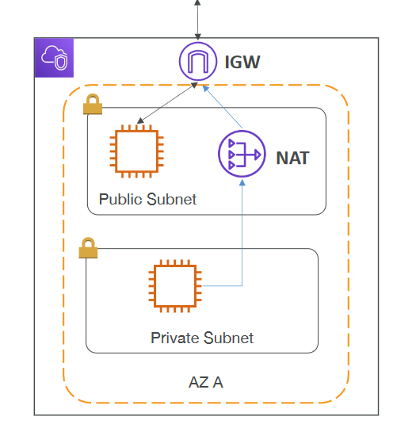
VPC (Virtual Private Cloud)

Slide 52
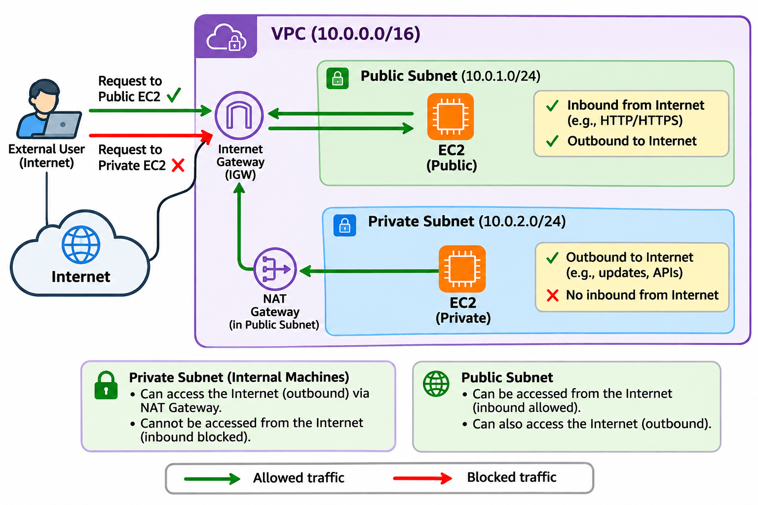

Slide 53
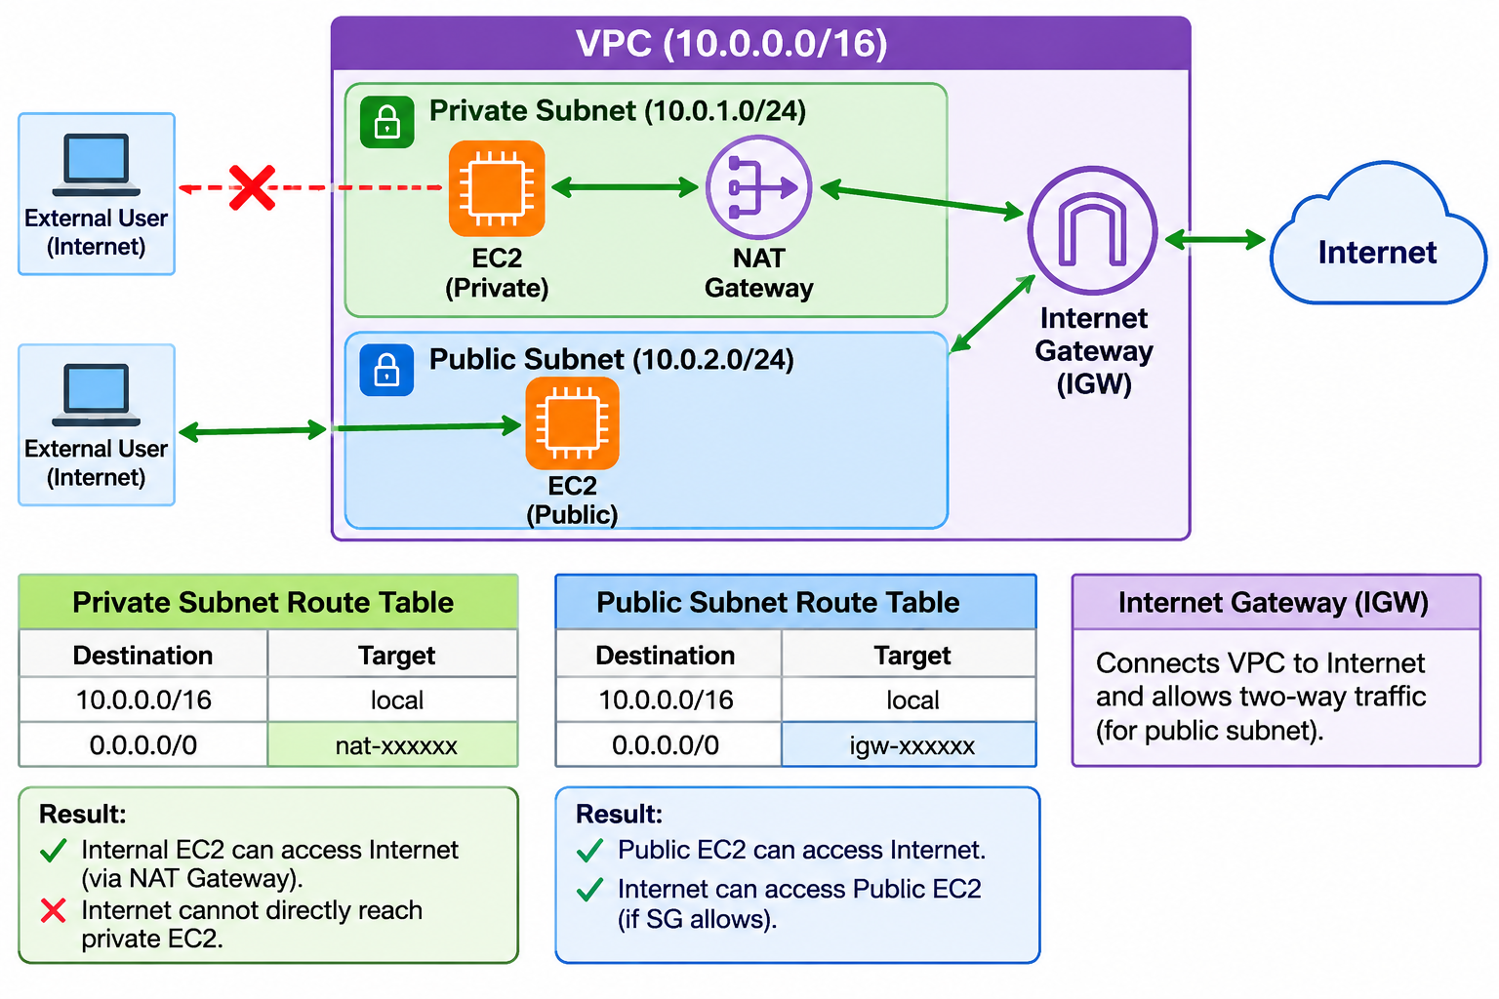

Slide 54
VPC
Component | Description / Purpose
VPC (Virtual Private Cloud) | A logically isolated portion of the AWS network within a region — like your own private data center in the cloud.
Subnet | A partition or segment of a VPC used to organize and control network resources.
Public Subnet | A subnet that is accessible from the Internet (via an Internet Gateway).
Private Subnet | A subnet that is not directly accessible from the Internet; used for internal resources.
Route Table | Defines how network traffic is directed — to the Internet, between subnets, or to other networks.
Internet Gateway (IGW) | A gateway that allows communication between the public subnets in your VPC and the Internet.
NAT Gateway (Network Address Translation) | Allows instances in private subnets to initiate outbound connections to the Internet (e.g., for updates) while remaining inaccessible from outside.

Slide 55
Problem
Create a new VPC by the name ditiss-lab with public & private subnet.
Assign network address as 172.20.0.0/16.
Assign 172.20.0.0/16 to the public and 172.20.10.0/24 to the private subnet.
Create one instance and connect to a private subnet.
Create one instance and connect to the public subnet.
Install httpd on the private instance and check with curl from the public connected instance.

Slide 56

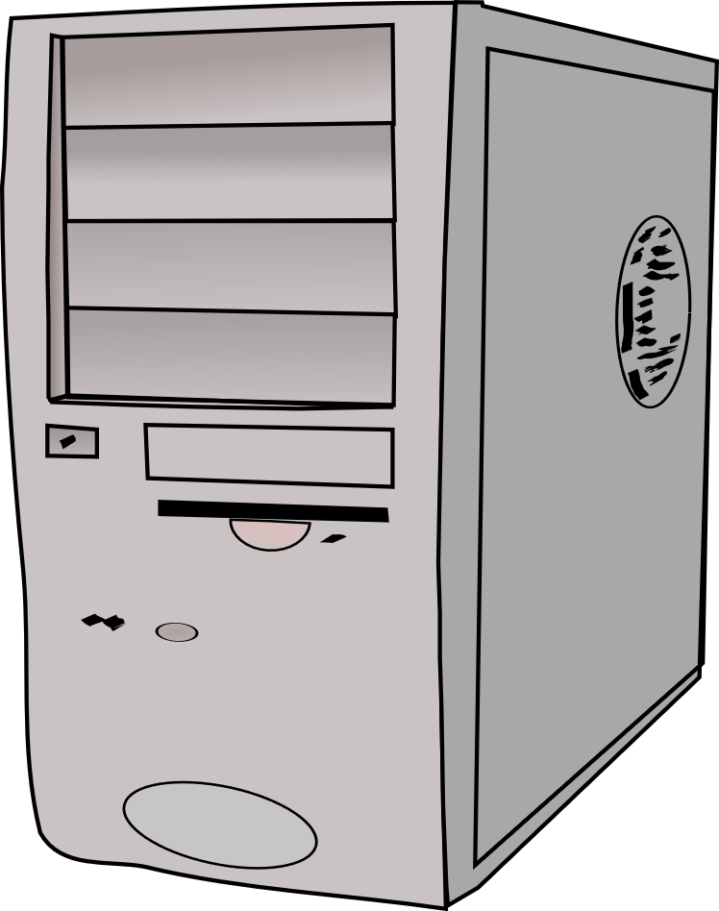
SSH and copy .pem file
VPC
Public subnet
Private subnet
Install Apache Web server and access it

Slide 57


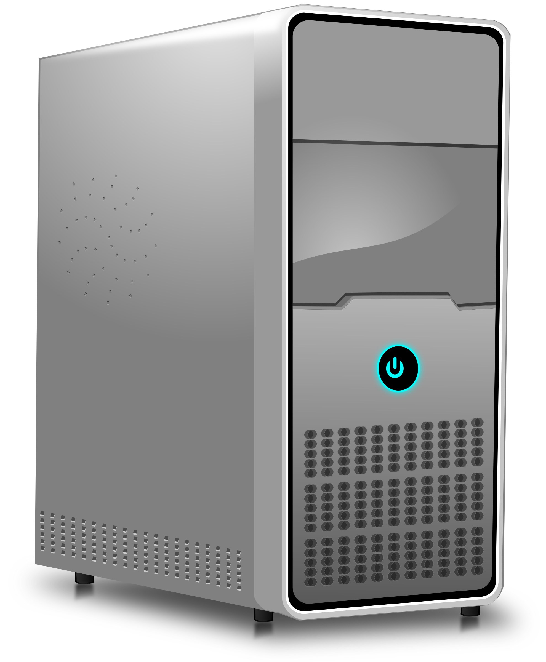

copy
ssh
ssh
Step 1: On the Windows machine, convert .ppk file into .pem file using PuttyGen
Step 2: Copy .pem file into Lubuntu machine and change permissions
Step 3: Go to EC2-PUBLIC using its PUBLIC IP address
Step 5: Go to EC2-PRIVATE using its PRIVATE IP address
There: Install and start Apache
winSCP
putty
Step 6: Go to EC2-PUBLIC using its PUBLIC IP address
There: curl PRIVATE IP of PRIVATE INSTANCE
Step 4: Copy .pem file into PUBLIC EC2 instance using PUBLIC IP

Slide 58
Action | Create a new VPC
VPC Type | VPC and more
Name tag | my-ditiss-lab
IPv4 CIDR block | 172.20.0.0/16
Number of Availability Zones | 1
Number of Public Subnets | 1
Number of Private Subnets | 1
Customize Subnet CIDR Blocks | Open / Enabled
Public Subnet CIDR Block | 172.20.0.0/17
Private Subnet CIDR Block | 172.20.128.0/17
NAT Gateway | Zonal -> In 1 AZ
VPC Endpoints | None
DNS options | Check both boxes (Enable) -> Create VPC

Slide 59
EC2 -> Launch Instance (2 Instances, One by One)
Step / Field | Value / Selection
Action | Create a new EC2 instance
AMI | Amazon Linux
Instance Name | My-EC2-public-instance
Key Pair | Reuse/Generate
Network Settings | Edit
VPC | my-ditiss-lab
Subnet | Select the Public subnet
Auto-assign Public IP | Enable
Final Step | Click Launch instance
Step / Field | Value / Selection
Action | Create a new EC2 instance
AMI | Amazon Linux
Instance Name | My-EC2-private-instance
Key Pair | Reuse the same keypair
Network Settings | Edit and open port 80
VPC | my-ditiss-lab
Subnet | Select the Private subnet
Auto-assign Public IP | Disable
Final Step | Click Launch instance

Slide 60
Our machine -> Public Instance -> Private Instance
Note the public IP of the public EC2 instance
Open Putty and try to connect to this public instance
If connection is successful, login as ec2-user
Now open Puttygen -> File -> Load private key -> Your .ppk file -> Conversions -> Export SSH key -> Warning: Say Yes -> Save the file as same file name but .pem extension
Now run winscp -> Login: Enter public IP of public EC2 instance -> User: ec2-user -> Advanced -> SSH -> Authentication -> Select your .ppk file -> Ok -> Login
Copy the .pem file from left (Windows) to right (Linux) by dragging it
Go back to puttygen terminal and run command: chmod 400 <your .pem file name>
From this public instance, SSH into the private instance: ssh -i <.pem file> ec2-user@<private IP of private instance>

Slide 61
Apache Installation and Testing
If you have successfully connected to the private IP of the private instance, run the steps below
Install Apache: sudo yum install httpd -y
Only if you get errors: echo "nameserver 8.8.8.8" | sudo tee -a /etc/resolv.conf
Start Apache service: sudo service httpd start
Enable Apache: sudo chkconfig httpd on
Test locally: curl localhost
Start Putty and connect to public IP of public instance
From the public instance, curl <private IP of private instance>

Slide 62
Cleanup
CLEAN UP EVERYTHING!
EC2 instances – Both Public and Private – Stop
Subnets (That we have created)
Network interfaces (That we have created)
Internet Gateway, NAT Gateway (That we have created)
Elastic IP
VPC (That we have created)

Slide 63
Singularity
Feature | Docker | Apptainer
Primary Use | Web apps, microservices, DevOps | HPC, research, academic environments
Architecture | Client + daemon (dockerd) | No daemon (runs directly)
Root Requirement | Usually requires root privileges | Runs as normal user (no root needed)
Security Model | Less strict (daemon runs as root) | Strong security (no privilege escalation)
HPC Compatibility | Often restricted | Designed for HPC clusters
Image Format | Layered images | Single .sif file
Image Mutability | Writable (layers can change) | Immutable (read-only by default)
Performance | Slight overhead due to daemon | Near-native performance
Ease of Use | Very easy, huge ecosystem | Slight learning curve
Networking | Full virtual networking | Shares host network
Storage | Layered filesystem | Single-file container
Portability | High | Very high (single file easy to move)
Ecosystem | Huge (Docker Hub, tools) | Smaller but growing
Kubernetes Support | Native | Not directly used with K8s
Best For | CI/CD, cloud apps, microservices | AI/ML research, simulations, labs

Slide 64
Singularity on Linux Machine
# | Action | Command
1 | Install dependencies (Ubuntu/Debian) | sudo apt update && sudo apt install -y build-essential libseccomp-dev pkg-config uidmap squashfs-tools cryptsetup curl wget git
 | Install dependencies (RHEL/CentOS) | sudo yum groupinstall -y "Development Tools" && sudo yum install -y libseccomp-devel wget git squashfs-tools cryptsetup
2 | Install Go | wget https://go.dev/dl/go1.22.0.linux-amd64.tar.gz
 |  | sudo tar -C /usr/local -xzf go1.22.0.linux-amd64.tar.gz
 | Set PATH | echo 'export PATH=/usr/local/go/bin:$PATH' >> ~/.bashrc && source ~/.bashrc
 | Verify Go | go version
3 | Download source | git clone https://github.com/apptainer/apptainer.git
 |  | cd apptainer && git checkout v1.3.0
4 | Build & install | ./mconfig
 |  | make -C builddir
 |  | sudo make -C builddir install
5 | Verify | apptainer --version

Slide 65
Examples
sudo apptainer run docker://alpine
  cat /etc/os-release
  ls -la
  exit
Execute a command inside a container
  sudo apptainer exec docker://alpine echo "Hello from container“
Test Python inside a container
  sudo apptainer exec docker://python:3.9 python -c "print('Hello Python')"

Slide 66
Building a Custom Image
nano hello.def
  Bootstrap: docker
  From: alpine
  %runscript
  echo "Hello, World from inside Apptainer!“
Build image: sudo apptainer build hello.sif hello.def
Run container: sudo ./hello.sif OR sudo apptainer run hello.sif

